Slide 1
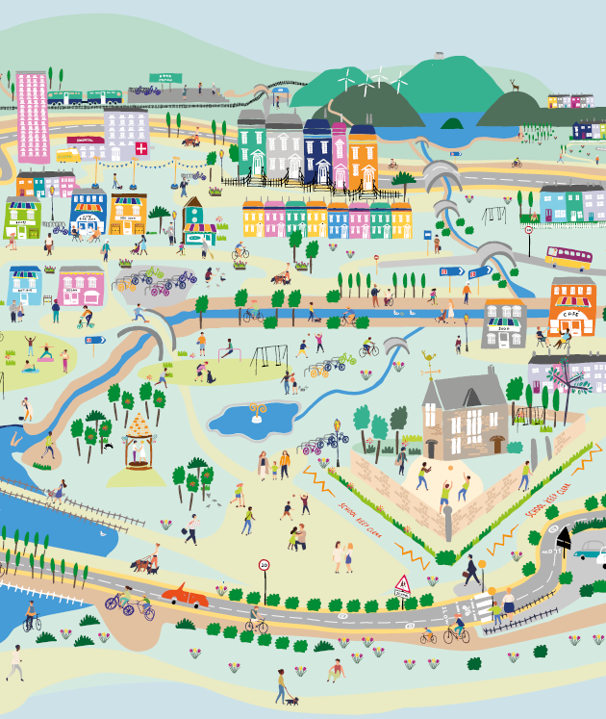
Session 3: Evaluate
Places that are good for the planet and for people
Creating 20 minute neighbourhoods

Slide 2
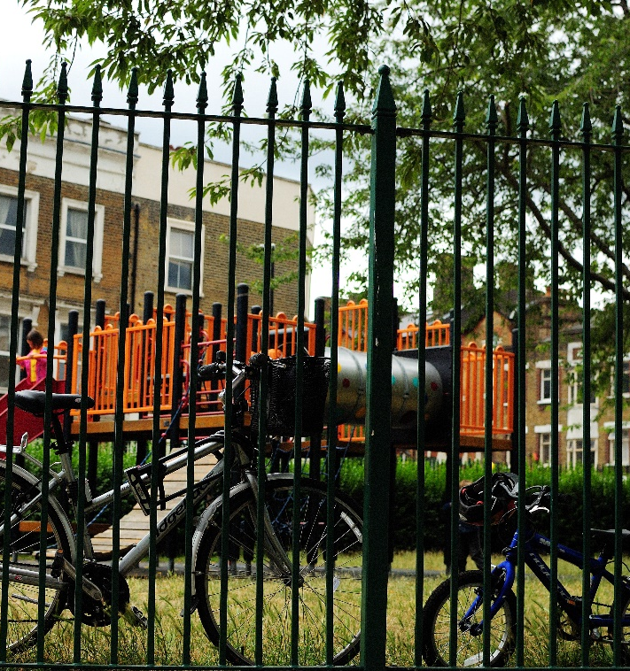
Overview
Engage: Climate change, COP26, 20 min neighbourhoods
Explore: Go out into our local neighbourhood.
Evaluate
  What is good about our local 20 minute neighbourhood?
  What is missing from our 20 minute neighbourhood
  What would we like to improve?
Create: How would we design our local neighbourhood?
Notes:
This is the third of four workshops, where pupils will think about how well your neighbourhood measures up to the 20 minute neighbourhood concept and discuss what they would like to improve
The four sessions are outlined in the slide:
Engage – learn about COP26, how we can create places that are good for the planet and for people
Explore – go out and explore your own 20 minute neighbourhood
Evaluate – think about how well your neighbourhood measures up; what was good and what could be better
Create – design a vision of a 20 minute neighbourhood

Slide 3
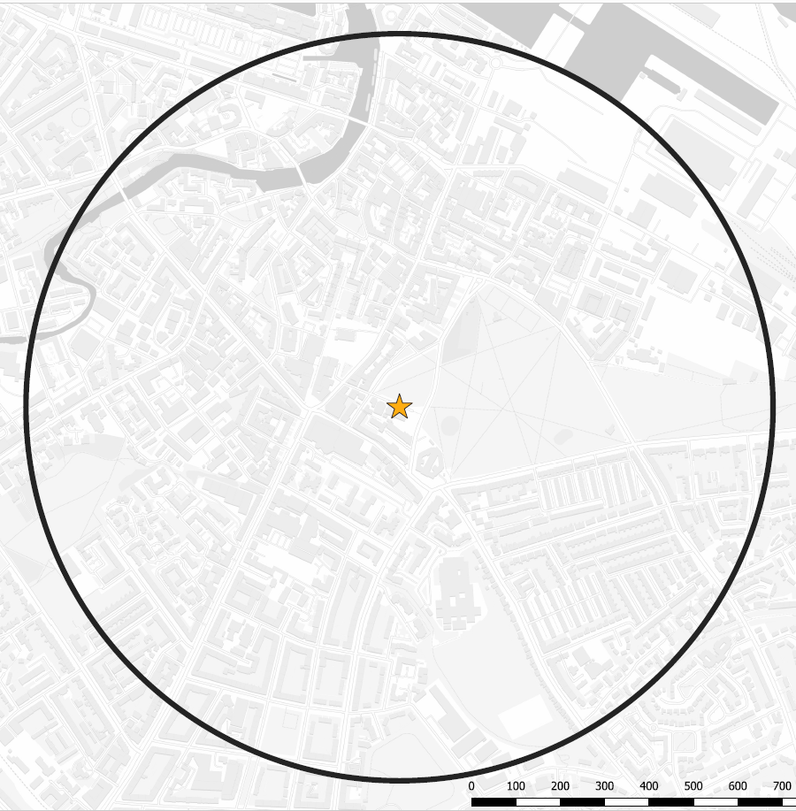
Evaluating our local 20-min neighbourhood
Task: Working in groups (4-6 people) and using your surveys from last session, annotate the map showing what you found.
Annotate the map showing what you found during your walk.
You could;
  Shade areas of the map to represent different things, for example; greenspaces, areas which are busy with traffic, pedestrianised areas etc.
  Add symbols to show different features you have found. There are symbols you can cut out and stick on if you don’t want to draw your own.
Add items to the key to explain what different colours and symbols mean.
See the next slide for some examples.

Slide 4
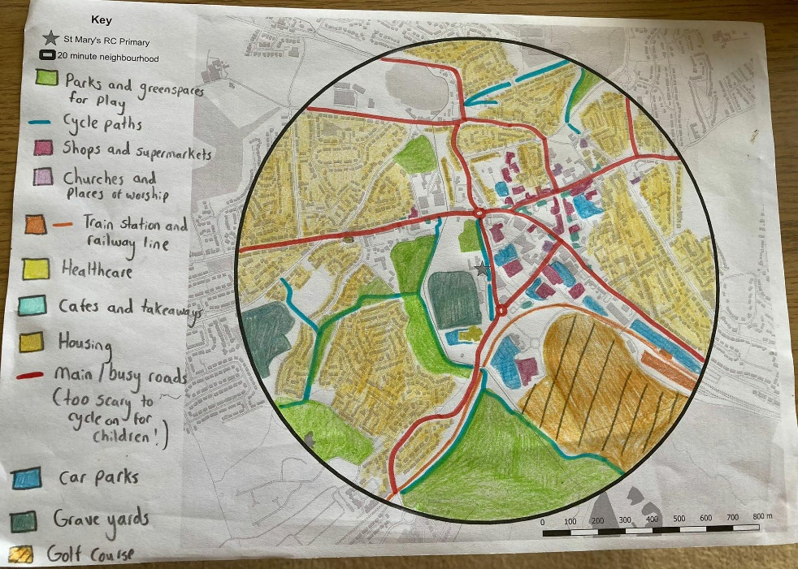

Slide 5
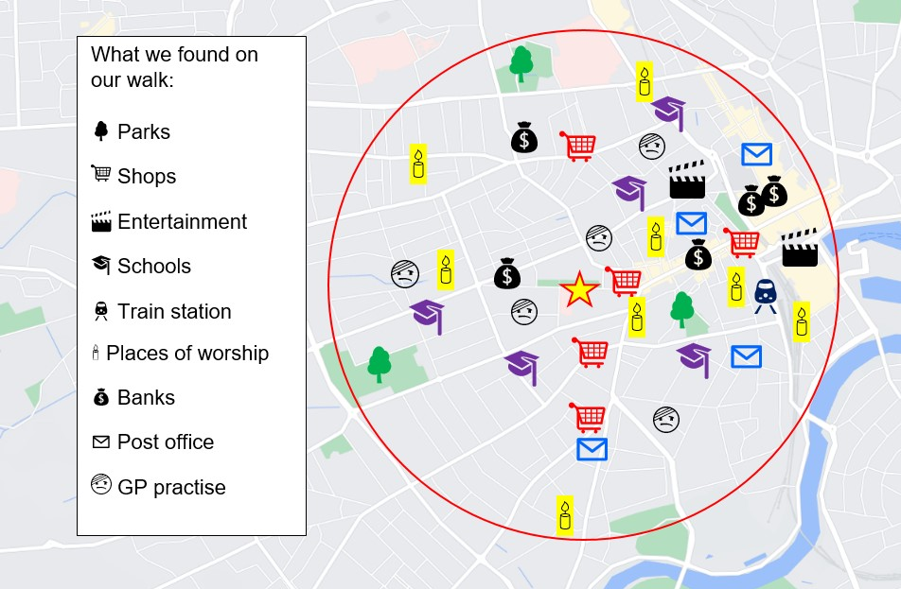

Slide 6
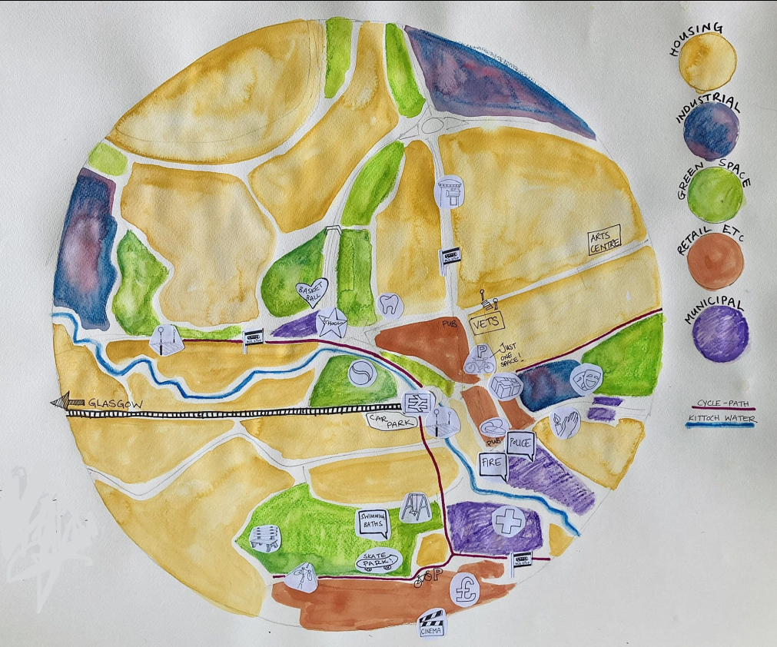

Slide 7
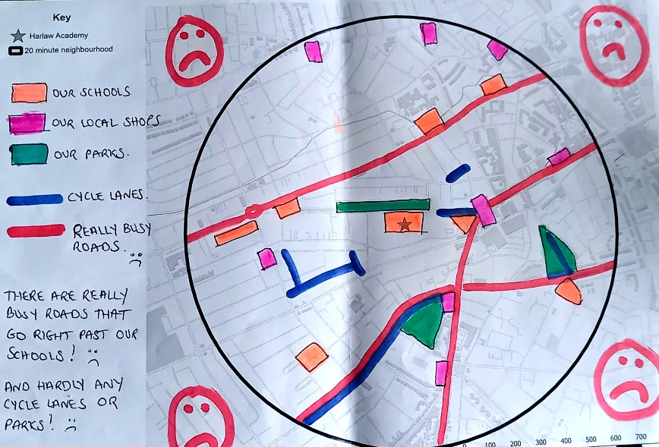

Slide 9
Evaluating our local 20-min neighbourhood
Task: Working in groups (4-6 people) and using your surveys from last session, annotate the map showing what you found.
Add annotations showing how your local area could be improved.
You could;
  Identify features that are missing and think about where they could go
  Think about things you’ve seen in other places, and whether your neighbourhood would benefit from them
Add items to the key to explain what different colours and symbols mean.
See the next slide for some examples.

Slide 10
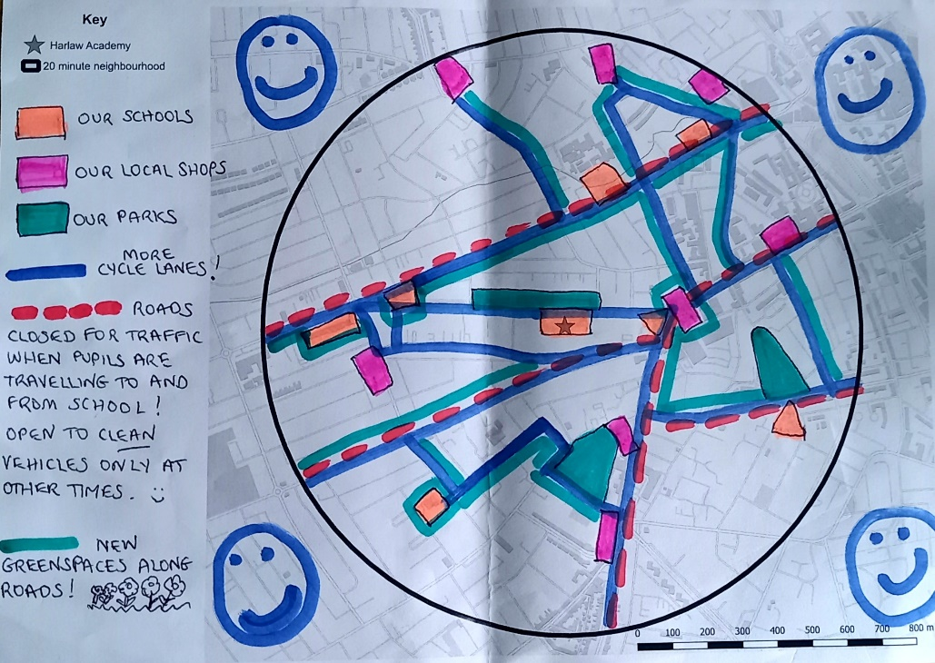

Slide 11
