Slide 1
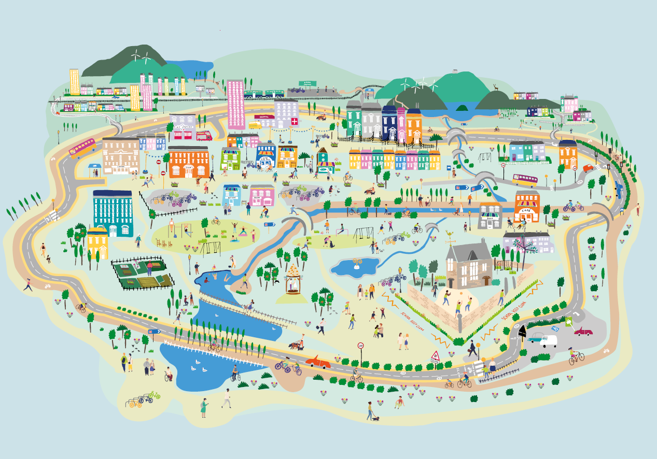
Session 1: Engage
Places that are good for the planet and for people
Creating 20 minute neighbourhoods

Slide 2
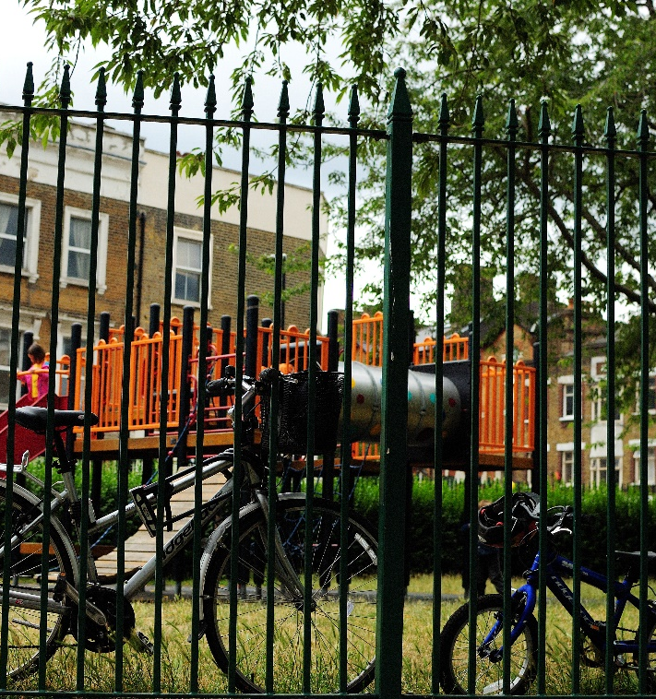
Overview
Engage
Climate change and COP – what are they are how do they link?
What is Scotland doing to tackle Climate Change?
How could our local neighbourhood become a place that is good for both the planet and for people?
Explore: Go out into our local neighbourhood.
Evaluate: How does out local neighbourhood measure up?
Create: How would we design our local neighbourhood?
Notes:
This is the first of four workshops, through which pupils will develop an understanding of why changing how we live can help tackle climate change, and learn about 20 minute neighbourhoods.
The four sessions are outlined in the slide:
Engage – learn about COP26, how we can create places that are good for the planet and for people
Explore – go out and explore your own 20 minute neighbourhood
Evaluate – think about how well your neighbourhood measures up; what was good and what could be better
Create – design a vision of a 20 minute neighbourhood
Overview of this session
What is COP26, and why is it important?
Who are Sustrans, and what are we doing about climate change and COP?
Government transport targets?
How could the places we live be changed to help create make both the planet and people healthier? What is a 20 minute neighbourhood?
Prepare for the next session – work out where we want to explore in our 20 minute neighbourhood.

Slide 3
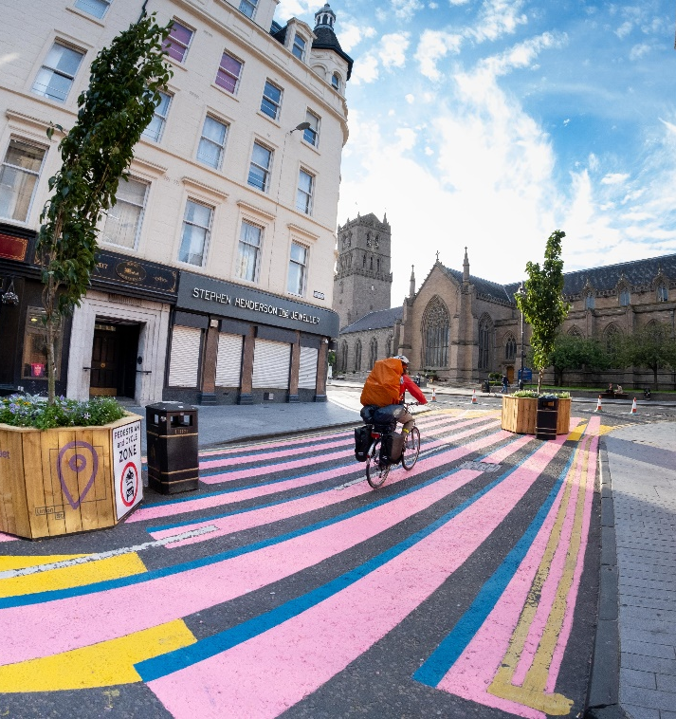
Sustrans
These workshops have been designed by Sustrans, a walking and cycling charity.
Their vision is a society where the way we travel creates healthier places and happier lives for everyone.
They are concerned about climate change, as transport emits lots of greenhouse gases.
Most emissions from transport are caused by people driving their cars.
Notes:
These workshops have been designed by Sustrans, a British walking a cycling charity.
Their vision is a society where the way we travel creates healthier places and happier lives for everyone.
Their mission is to make it easier for people to walk and cycle.
They are concerned about climate change, as transport emits lot of greenhouse gases.

Slide 4

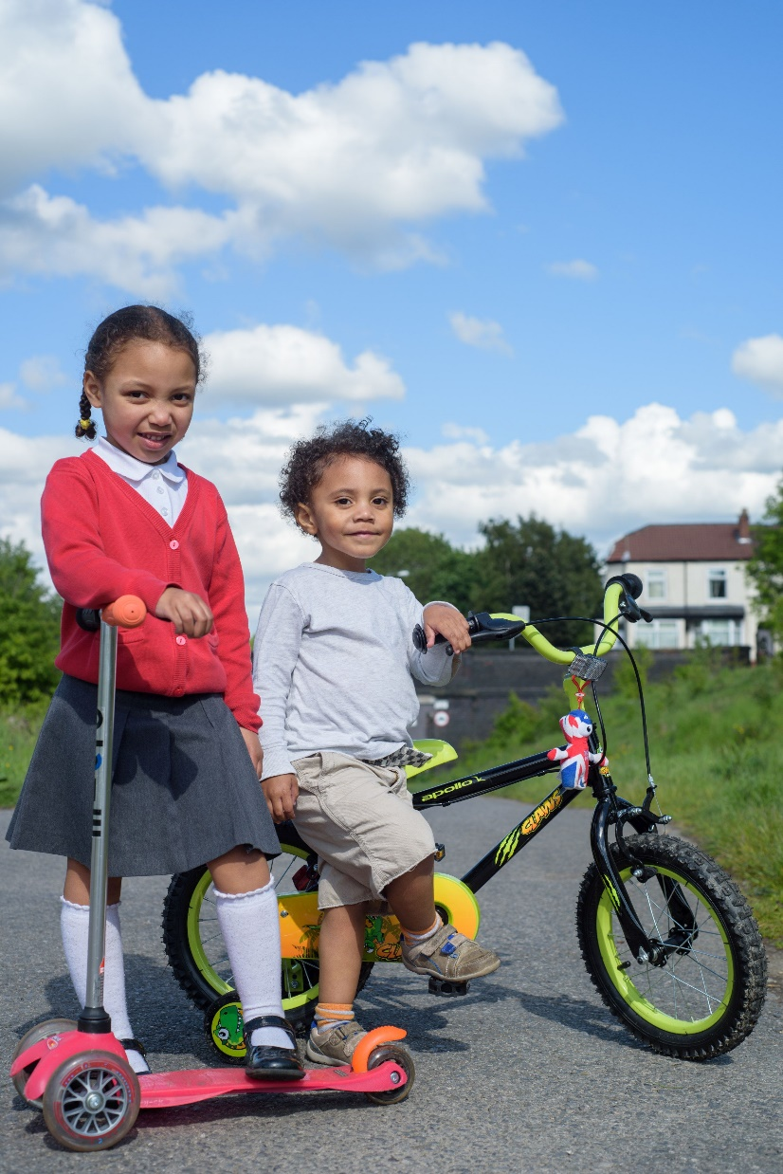

Climate Change
& COP26
What is COP26, and why is it important?
Document title | 20 August 2021

Slide 5

What is Climate Change?
Definition: Change happening to our global climate over a long period of time
What’s the difference between weather and climate?
Global temperatures have been rising for over 100 years, and are now the highest on record.
This is changing our weather which impacts people, animals and plants around the world.
Notes:
Q: What is climate change? Can anyone give me a definition?
Climate change is change that happens to our global climate over a long period of time.
Weather is something that happens day to day – today it might be warm and sunny, but tomorrow could be cold and rainy.
Climate is the average kind of weather places get. In Scotland, out Climate could be described as ‘temperate’ – it doesn’t tend to get too cold or too hot, and we don’t usually get droughts or big floods.
Global temperatures have been rising for over a century and accelerating over the past 30 years, with temperatures now the highest on record.
This is affecting weather patterns which impacts people, animals, and plants. People and wildlife often can’t keep up with the changes that are happening to their homes.

Slide 6
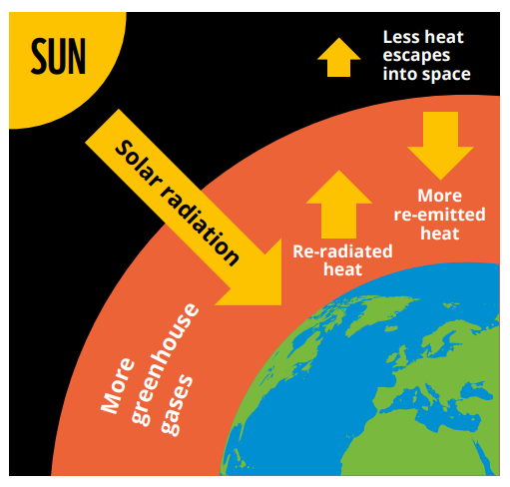
What causes Climate Change?
Modern Climate Change is caused by people.
Human activity is releasing greenhouse gases into the atmosphere.
These gases include carbon dioxide, methane, and CFCs.
These emissions are causing the planet to warm up by trapping the sun’s heat.
Where do these greenhouse gases come from?
Notes:
What causes Climate Change?
Modern climate change is caused by human activity, which is releasing greenhouse gases into the atmosphere.
These gases are carbon dioxide, surface level ozone, water vapour, methane, nitrous gases, and CFCs (Chlorofluorocarbons).
The biggest contributor to the warming effect is carbon dioxide, which is released by burning fossil fuels for energy, farming, and destroying forests.
These emissions are causing the greenhouse effect – trapping heat and making the Earth warmer to an extent that can’t be explained by natural factors alone.
In the past (millions of years) the climate has changed due to natural forces, such as volcanic eruption or fluctuation in the suns activity. However, the difference now is that the amount of greenhouse gases in the atmosphere is much higher than ever recorded, and is still rapidly rising due to human emissions.

Slide 7


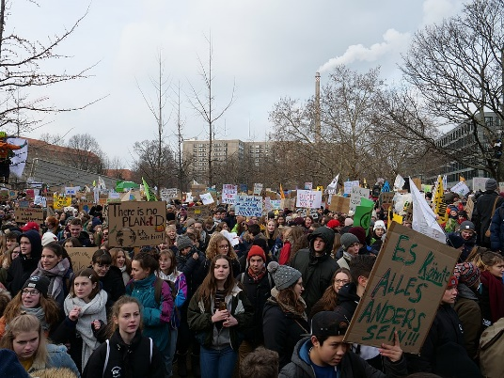

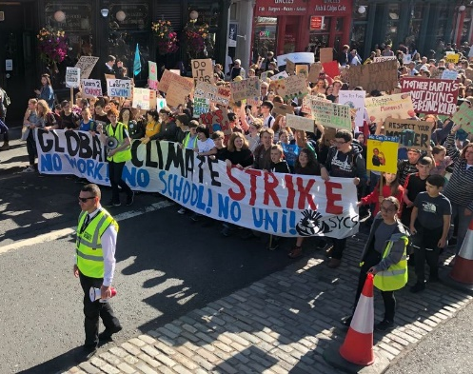
What are young people doing?
Notes:
Discussion around the school strikes.
Why were young people striking? Did any of you strike? Why/why not? What are they trying to achieve?

Slide 8

What is COP26?
Notes:
What is COP26?
Ask the class what they already know.
Q: Does anyone know anything about COP26 already?

Slide 9

What is COP26?
COP26 (Conference Of the Parties) is a United Nations Climate Change Conference.
It’s a global event where leaders from countries across the world come together to discuss how they’re going to tackle Climate Change.
It will be held in Glasgow from 1-12 November.
Aim: To stabilise greenhouse gas concentrations at a level that will stop dangerous human-caused climate change
Notes:
COP26 is a United Nations Climate Change Conference. It’s a global summit where leaders from countries around the world come together to discuss how they are going to tackle climate change.
COP stands for Conference of the Parties, and will be attended by counties that signed the United Nations Framework Convention on Climate Change (UNFCCC) – a treaty agreed in 1994. The 2021 meeting will be the 26th meeting, which is why it’s called COP26. It will be held between 1-12 November 2021.
Objective: to stabilise greenhouse gas concentrations in the atmosphere at a level that would stop dangerous human-caused changes to the climate.

Slide 10
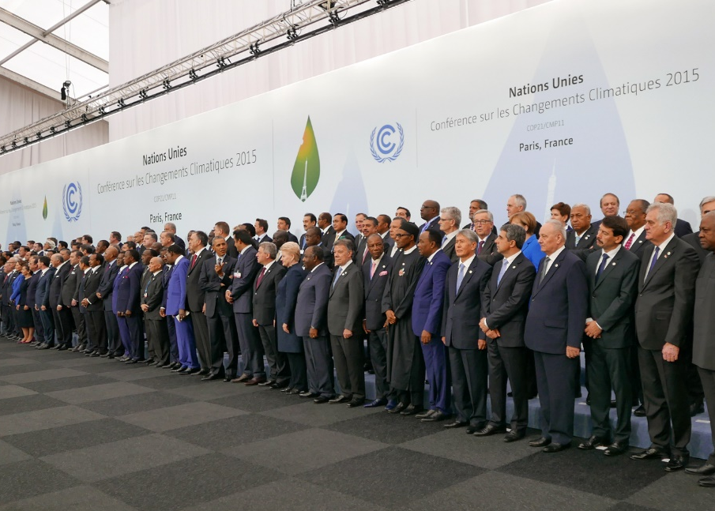
What will happen at COP26?
The focus of COP26 will be discussing the Paris Agreement, which was signed by 195 countries in 2015.
This agreement says that countries must:
Reduce their greenhouse gas production
Keep global temperature rise below 2°C
Review progress every 5 years
Spend $100 billion to help poorer counties
World leaders at COP21 in Paris
Notes:
The main topic of this year’s COP will be discussing the Paris Agreement, the agreement that 195 countries signed at COP21 in 2015.
The Paris Agreement says that nations must:
Reduce the amount of harmful greenhouse gases produced and increase renewable energy types
Keep global temperature increase below 2C, and try to limit it to 1.5C.
Review progress every five years
Spend $100 billion a year in climate finance to help poorer counties by 2020
But why are greenhouse gases and climate change important?

Slide 11
Where do UK Emissions come from?
UK Emissions (2019)
Agriculture
Buildings
Bunker Fuels
Electricity & Heat
Fuel Combustion
Industry
Manufacturing
Transport
Waste
Notes:
Can you match up the categories?
Bunker fuels are fuels use by ships.

Slide 12
Where do UK Emissions come from?
Notes:
How many did you get right? Did any surprise you?

Slide 13
Where do Transport Emissions come from?
UK Transport Emissions (2019)
Aviation (domestic)
Buses/coaches
Cars/taxis
HGVs
LGVs
Rail
Shipping (domestic)
Other
Notes:
Can you match up the categories?
Domestic aviation/shipping is flights and boat which only go between places in the UK. E.g. a flight from London to Edinburgh, or a ferry from Southampton to the Isle of White.
HGV = heavy goods vehicle
LGV = light goods vehicle

Slide 14
Where do Transport Emissions come from?
Notes:
How many did you get right?

Slide 15

What is Scotland doing?
Scotland’s Climate Change plan
Document title | 20 August 2021

Slide 16
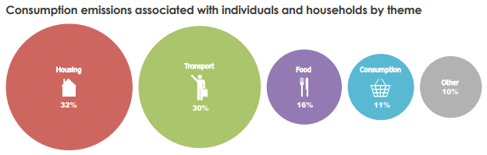
Scotland’s Climate Change Plan
The Scottish Government is aiming to reach net zero by 2045.
There are 7 key areas it is focussing on:
Electricity
Buildings
Transport
Industry
Waste
Land Use
Agriculture
Individual and household emissions by type
Notes:
The Scottish Government has committed to reduce emissions by 75% by 2030 (compared with 1990), and to net zero by 2045.
Q: What does net zero mean?
Talk about individual emissions

Slide 17
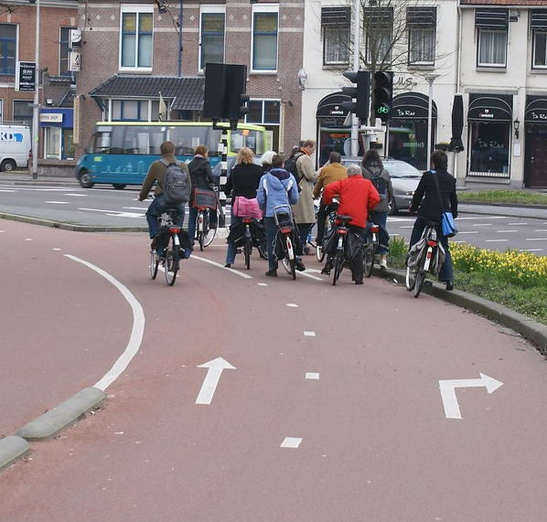
What does this mean for Transport?
No more petrol or diesel vehicles for sale by 2030. Instead, electric vehicles will be available.
By 2030 walking and cycling will be the most popular choice for everyday journeys.
Scotland will need more cycle paths, hire bikes, electric bikes, and cargo bikes
More places will be made into 20 minute neighbourhoods
Notes:
What does this mean for transport?
By 2030 there will be no more petrol or diesel cars for sale in the UK. Instead, people will only be able to buy electric vehicles.
Q: Are electric vehicles a solution?
Think about a busy street, and then imagine what it would look like if everyone owned electric cars instead.
Not on their own – although they reduce emissions, they still cause congestion.
By 2030 walking and cycling will need to be the most popular choice for everyday journeys. Scotland will need to invest in more cycle paths, to make sure that people can safely get where they need to go, and there will be more hire bikes, electric bikes, and cargo bikes.
Scotland will also be introducing more 20 minute neighbourhoods.

Slide 18
20 minute neighbourhoods
What are 20 minute neighbourhoods?
How can they help create places that are good for people and for the planet?

Slide 19
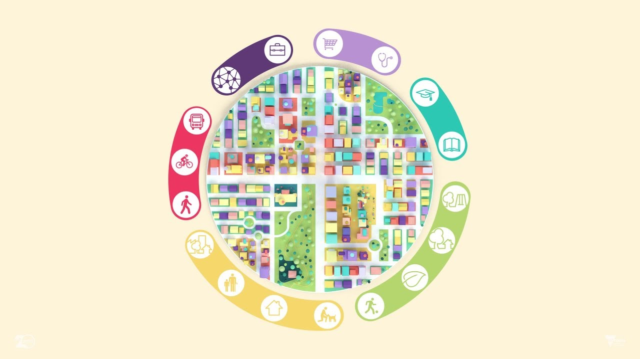
What is a 20 minute neighbourhood?
Notes:
The 20 minute neighbourhood is an idea that is becoming popular across the world.
Developed in different ways in cities like Melbourne, Portland and Paris, people can meet most of their essential needs within a 20 minute walk.
This means you can do your shopping, join in with leisure activities, take your children to school, find local services like your GP practice and ideally get to work – all within easy access of where you live.
It also means having greenspace on your doorstep and a local environment that encourages active travel to promote health and well‑being.
It is a place where people want to live, so affordable housing must be part of it.

Slide 20
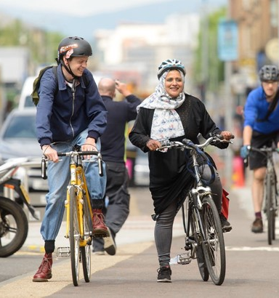

What is a 20 minute neighbourhood?
Sustrans wants to see places that connect us to each other and to what we need, where we can thrive without using a car.
They want liveable cities and towns for everyone.
They think the best way to do this is to ensure that it is easy for people to get to most places by a short 20 minute return walk.
10 minutes there, 10 minutes back.
What do we need to make this happen?
Notes:
At Sustrans, our goal for cities and towns is for them to be places that connect us to each other and what we need, where we can thrive without using a car.
We want liveable cities and towns for everyone.
We think that the best way to do this is to ensure that it is easy for people to meet most of their everyday needs by a short 20 minute return walk.
10 minutes there, 10 minutes back.
Why 20 minutes? Almost everyone can walk for 10 minutes in each direction. On average, this means that everything should be within an 800m (half a mile) walk.

Slide 21


Components of a 20 min neighbourhood
Places of work/learning
Places we need to go to
20 minute neighbourhood
Places we live
Places we want to go to
How we get there
Notes:
Mindmap in groups
Can use with or without hints/categories
Ask questions about where they need to go at least once a month, then get them to consider the needs of others.
For example they go to school, the park, to the supermarket, the cinema, whereas their parents might go to work, to the shops, to the doctors, to the train station etc.

Slide 22
Components of a 20 min neighbourhood
Work / Learning
Education
Nurseries
Primary Schools
High Schools
Employment
Offices
Other places where people can work
Libraries
Places we need
Health
Doctors
Dentists
Pharmacy
Food
Shops
Places to eat
Money
Banks
Post Offices
Places we want
Entertainment
Cinema/theatre
Community halls
Religious spaces
Sport
Sport fields
Swimming pools
Outside
Public parks
Playgrounds
Hang-out spaces
Places to live
Houses
Well maintained
Different types
  Flats
  Houses
  Care homes
Streets
Clean and tidy
Trees and plants
Feeling safe
How we get there
Public Transport
Buses, trams, trains
Active Transport
Cycle lanes
Footpaths and pavements
Safe crossings
Cars
Slow speeds
Reduced traffic

Slide 23
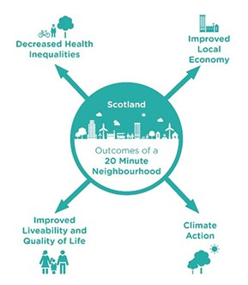

20 minute neighbourhoods in Scotland
The Scottish Government has said that they:
“support the idea of 20 minute neighbourhoods – where people can meet their needs within a 20 minute walk from their house – enabling people to live better, healthier lives and supporting our net zero ambitions”
Can you think of any other benefits of 20 minute neighbourhoods?
Notes:
In the Programme for Government 2020, the Scottish Government said they support the idea of 20 minute neighbourhoods – where people can meet their needs within a 20 minute walk from their house – enabling people to live better, healthier lives and supporting our net zero ambitions.
They will work with local governments across Scotland to make this happen.
Q: Would you like to live in a 20 minute neighbourhood?
How would you and other people benefit?

Slide 24
Route Planning
Where do we want to go?

Slide 25
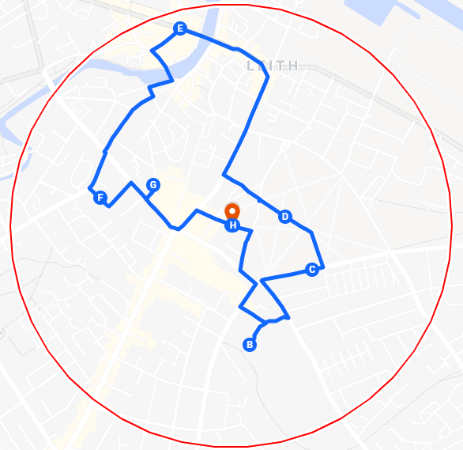
Your 20 Minute Neighbourhood
Using your map, work out a walking route to take you round your 20 minute neighbourhood.
Think about the different things you want to find in your neighbourhood.
Places of work/education
Places we need
Places we want
Where we live
How we get there
Notes:
Plan the route as a class using google maps, and making sure you stay within the boundary shown on your map.
(Unfortunately there’s no easy way to create a circle on google maps)
The map and instructions can then be printed to be used when outside.
When creating the route, consider the different elements of a 20 minute neighbourhood and try and plan the route around them, to showcase either what is or isn’t present in your neighbourhood.

Slide 26
Your 20 Minute Neighbourhood
Divide into groups to focus on different aspects of a 20 minute neighbourhood.
Work / Learning
Education
Nurseries
Primary Schools
High Schools
Employment
Offices
Other places where people can work
Places we need
Health
Doctors
Dentists
Pharmacy
Food
Shops and supermarkets
Money
Banks
Post Offices
Places we want
Entertainment
Cinema/theatre
Community halls
Religious spaces
Sport
Sport fields
Swimming pools
Outside
Public parks
Playgrounds
How we get there
Public Transport
Buses, trams, trains
Active Transport
Cycle lanes
Footpaths and pavements
Cars
Slow speeds
Reduced traffic
Places to live
Houses
Different types
  Individuals
  Families
  Older people
Affordable
Streets
Clean and tidy
Trees and plants
Feeling safe
Notes:
Divide the groups into teams. These teams will each focus on a different aspect of 20 minute neighbourhoods when they explore their local area next session.

