Slide 1

Sunnydale’s BIG Street Survey
Teamwork makes a dream work!
M
A
N
I
F
E
S
T
O

Slide 2
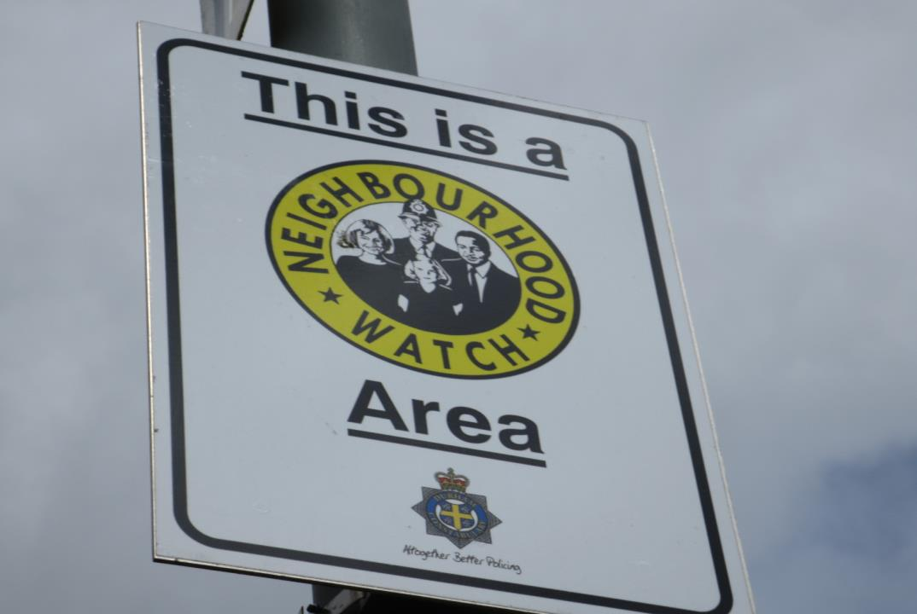
The Findings
2. The
Manifesto
3. The
Next Step

Slide 3
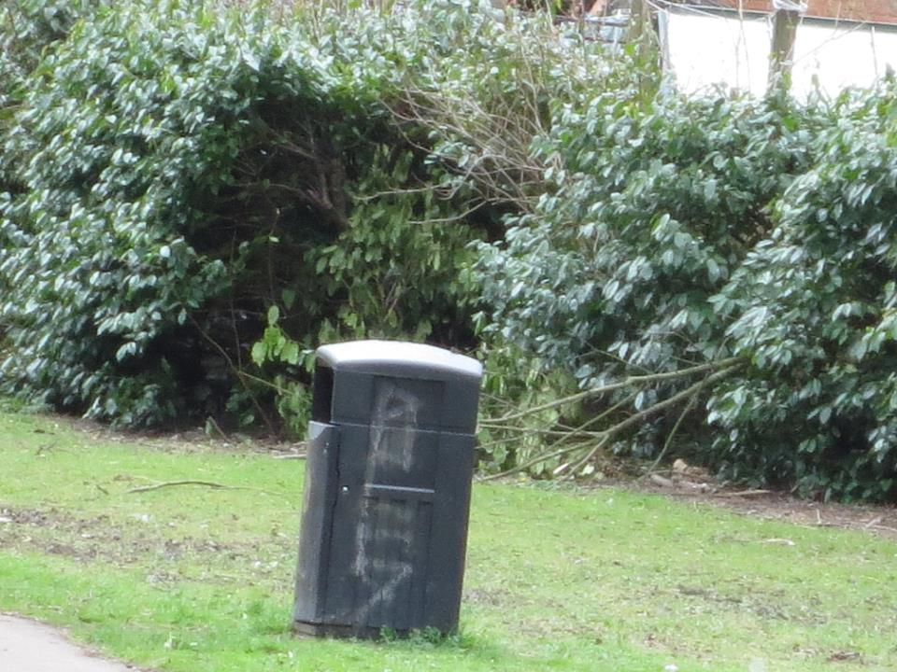
Litter
Survey Finding
Manifesto Point
Different types of litter e.g. Broken furniture, random wood and other
stuff!
Anti-littering campaign, competition and decorative bins.

Slide 4
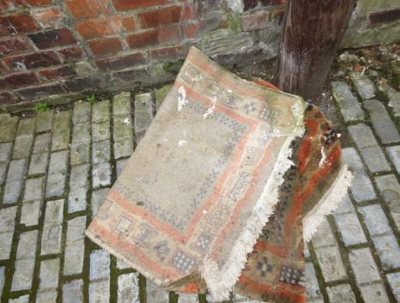
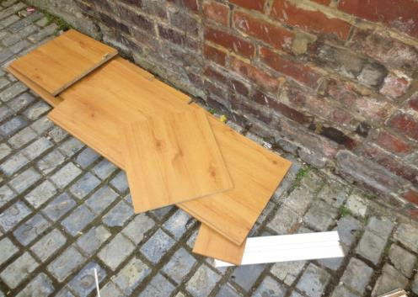
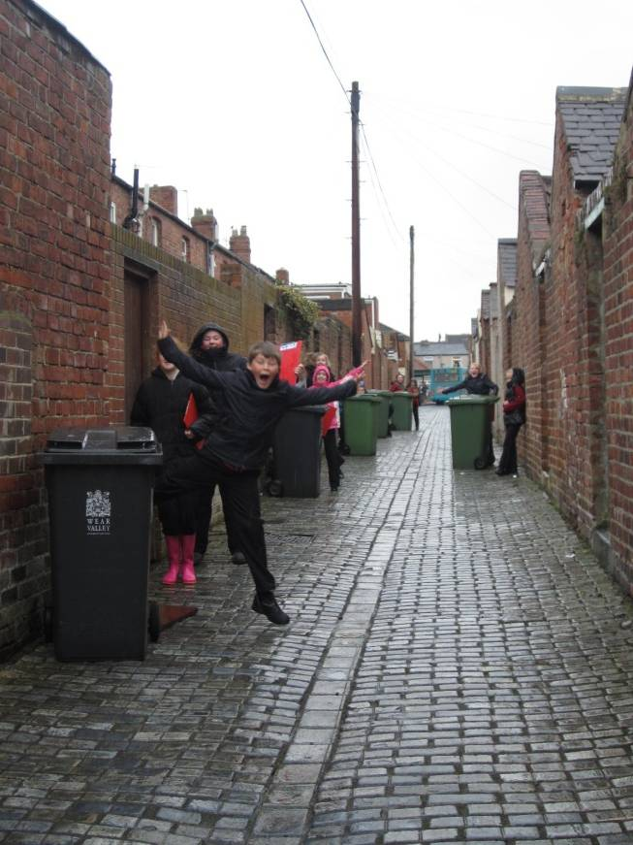
Street furniture
Survey Finding
Manifesto Point
All kinds of rubbish, litter and garbage
Help community groups do weekly checks

Slide 5
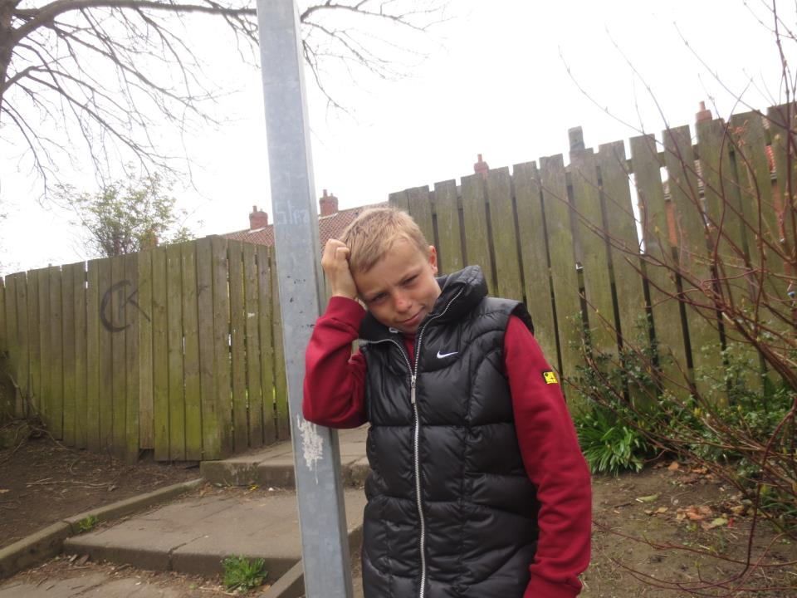
This pole doesn’t tell me anything – what is it doing here?!
...more unnecessary street furniture!

Slide 6
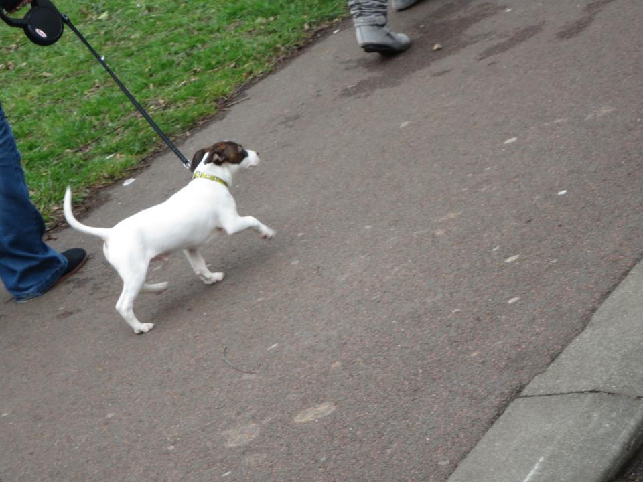
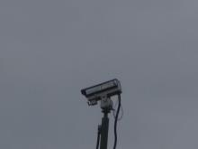
Dog Litter
Survey Finding
Manifesto Point
Unwanted dog litter on the streets.
More CCTV to find/fine irresponsible dog owners.

Slide 7
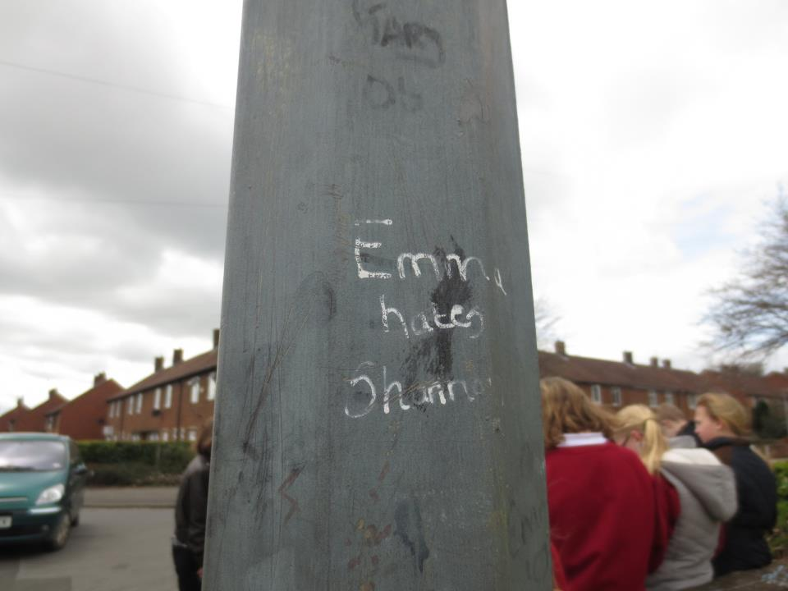
Graffiti
Survey Finding
Manifesto Point
Unnecessary graffiti
on other public/
private property
    Reduce boredom by improving our local park, e.g. Put the swings back into place, fix the radioed shelter and get a new stand for the tyre swing.
This is graffiti and messages like this do not create a good impression of Shildon.

Slide 8
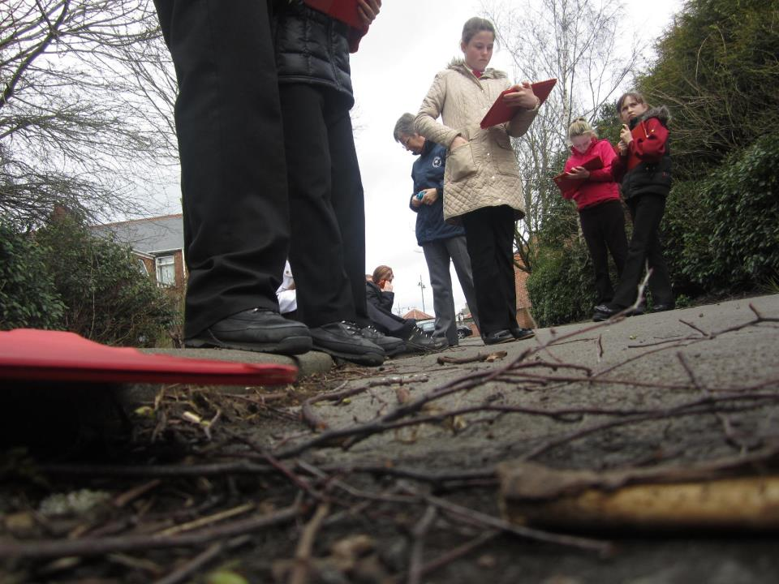
Places
Survey Finding
Solution
Not enough interesting/safe places to sit
Get the Shildon Youth Clubs to design places to sit

Slide 9
Sunnydale Yr 7 Manifesto
Anti-littering campaign competition & decorative bins.
Help community groups do weekly checks
More CCTV to find/fine irresponsible dog owners.
    4. Reduce boredom by improving our local park, e.g.
    Put the swings back into place, fix the radioed shelter and get a new stand for the tyre swing.
    5. Get the Shildon Youth Clubs to design places to sit

Slide 10
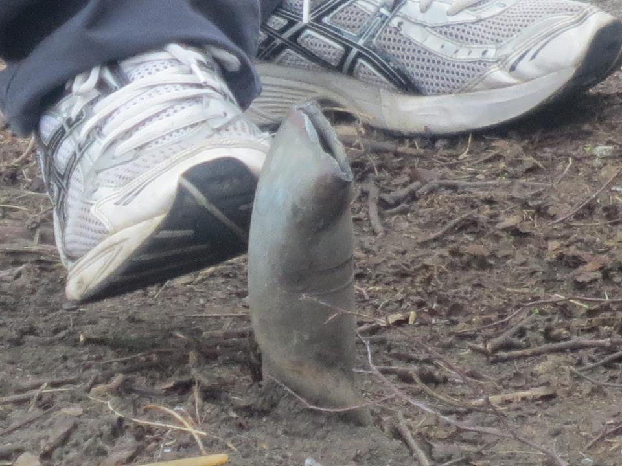
The next step!

Slide 11
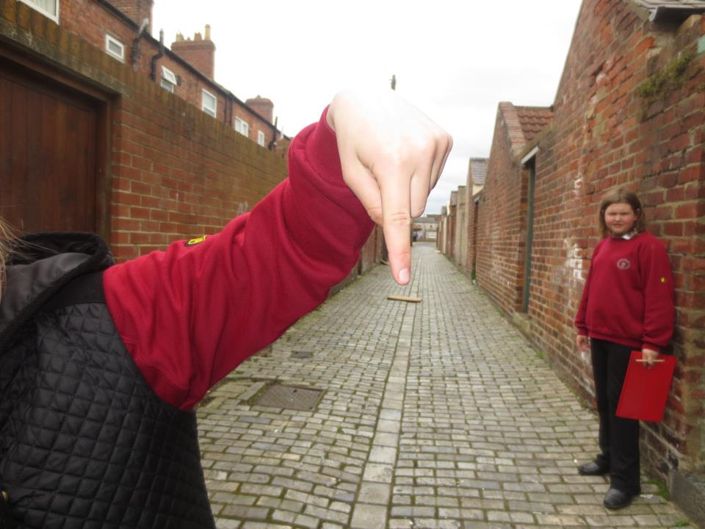
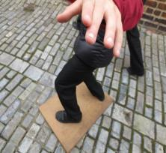
Finding creative solutions...
...to common problems

Slide 12
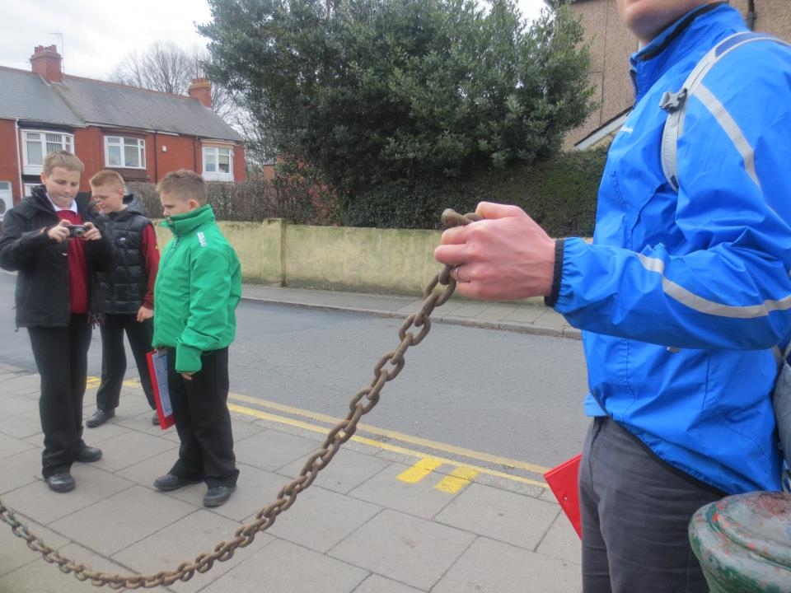
Making Stronger
Community Links
Schools
Council
Police
Community Groups

Slide 13

Manifesto Movies

Slide 14
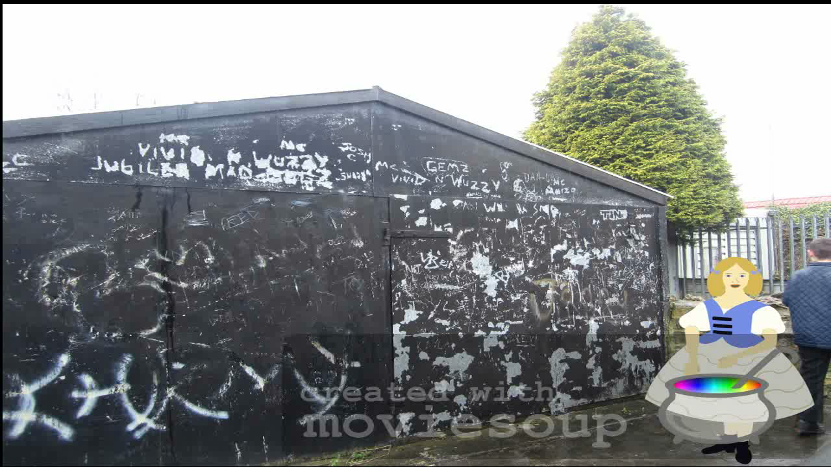

Slide 15
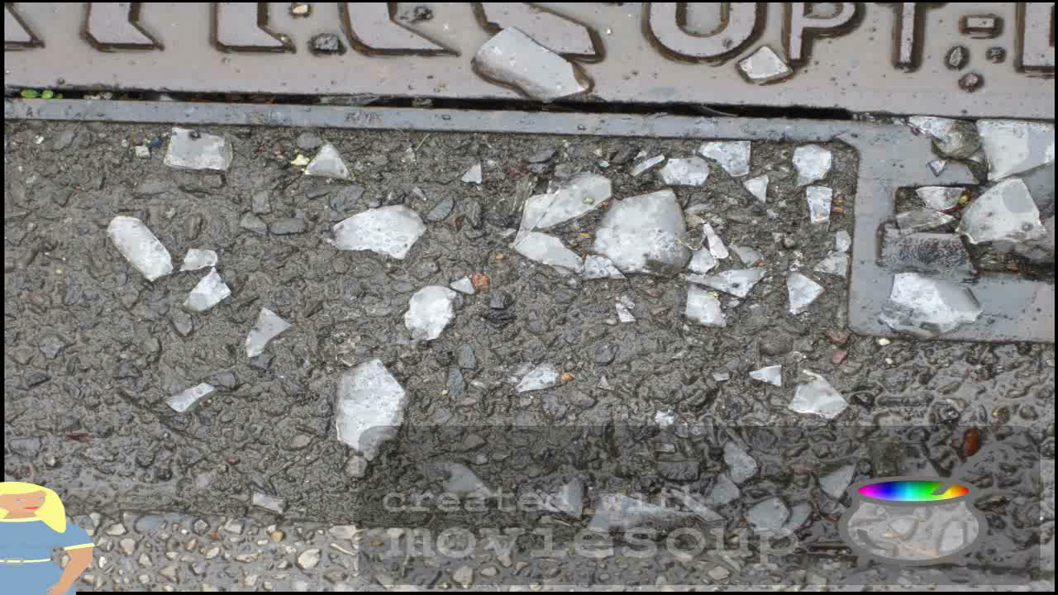

Slide 16
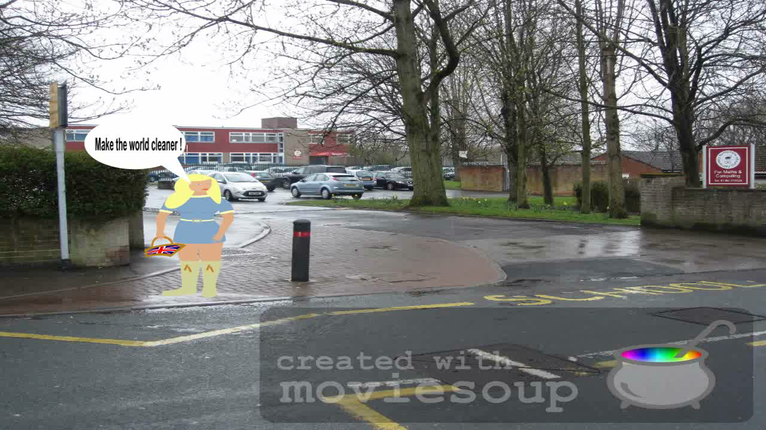

Slide 17
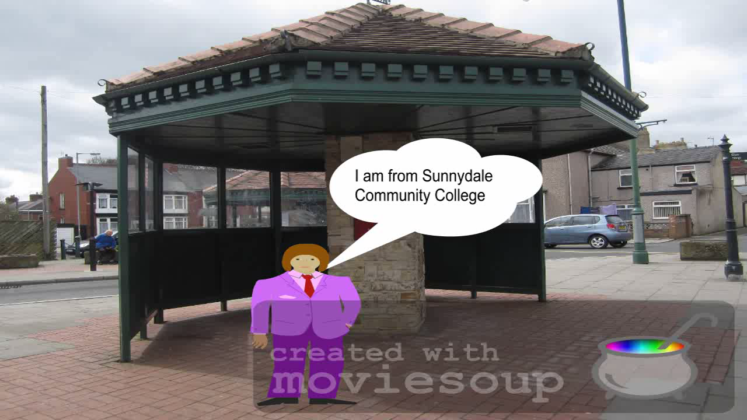

Slide 18
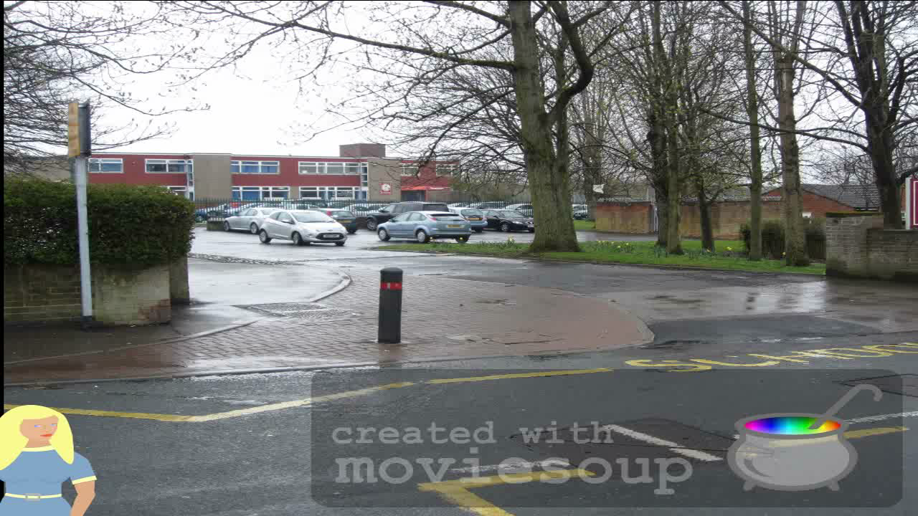

Slide 19
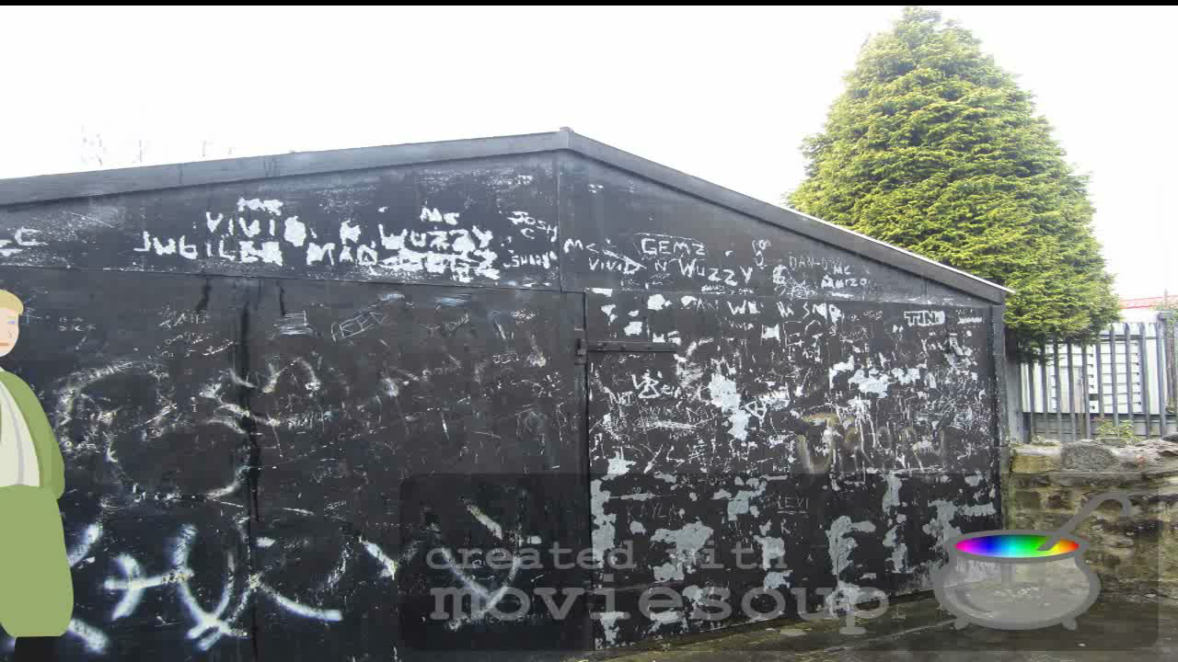

Slide 20


Slide 21
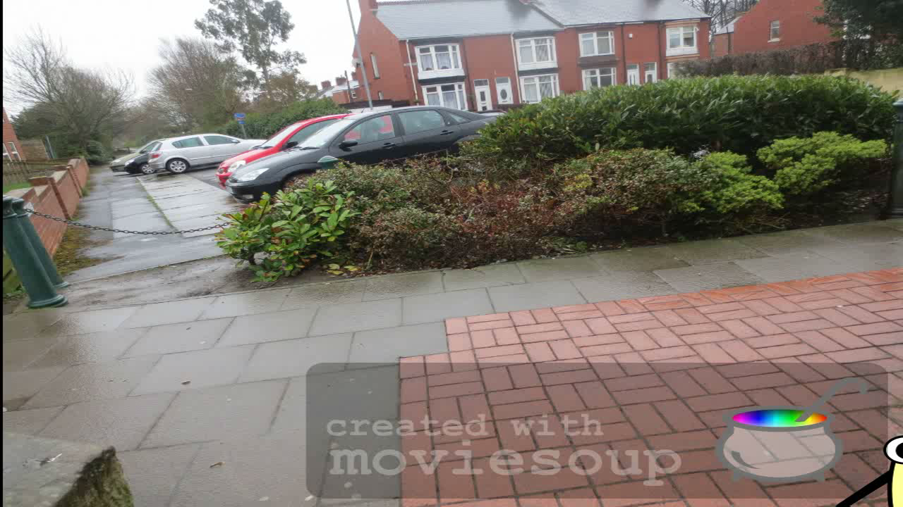

Slide 22
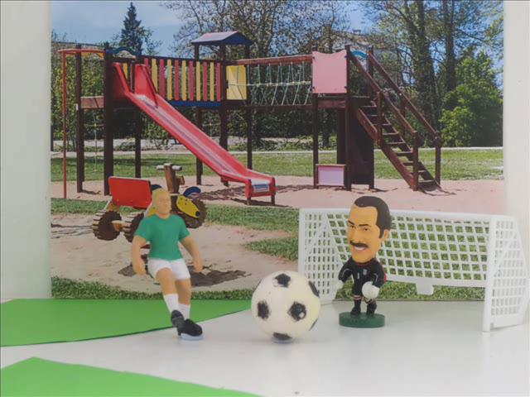

Slide 23
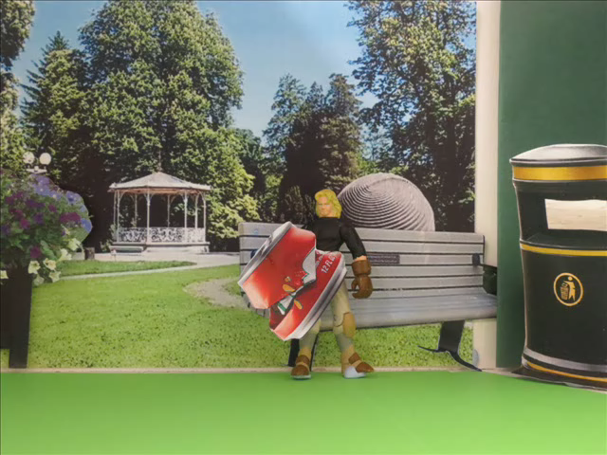

Slide 24
Interviews

Slide 25
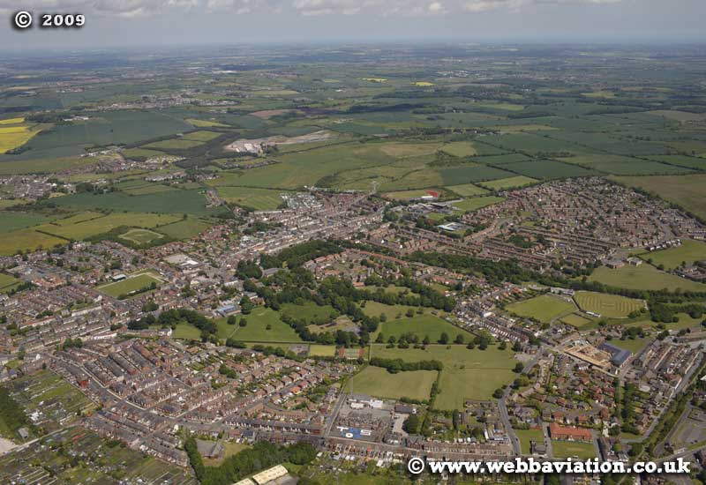
Sunnydale Community College

Slide 26
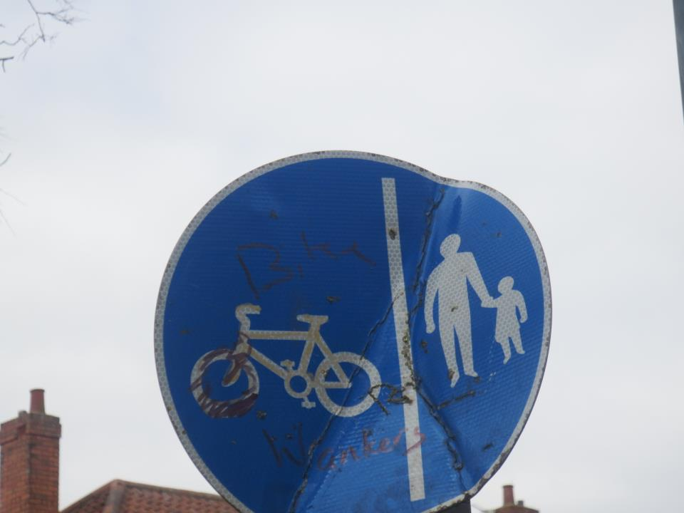
Save Shildon,
it’s your town,
don’t pull it to the ground!
Presenters:
Emily Anderson
Dylan Rutherford
Rhiannon McMahon

Slide 27
Competition

