Slide 1
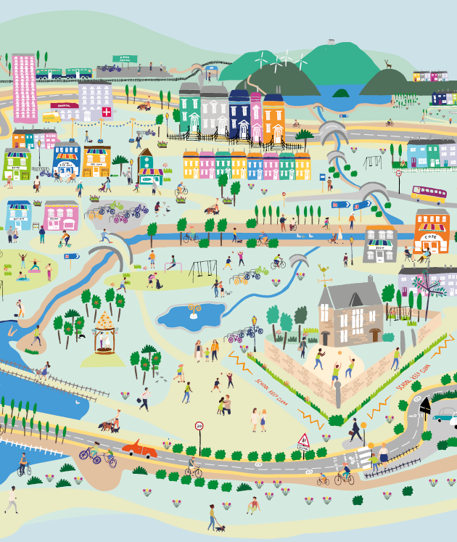



Session 4: Engage
Places that are good for the planet and for people

Slide 2
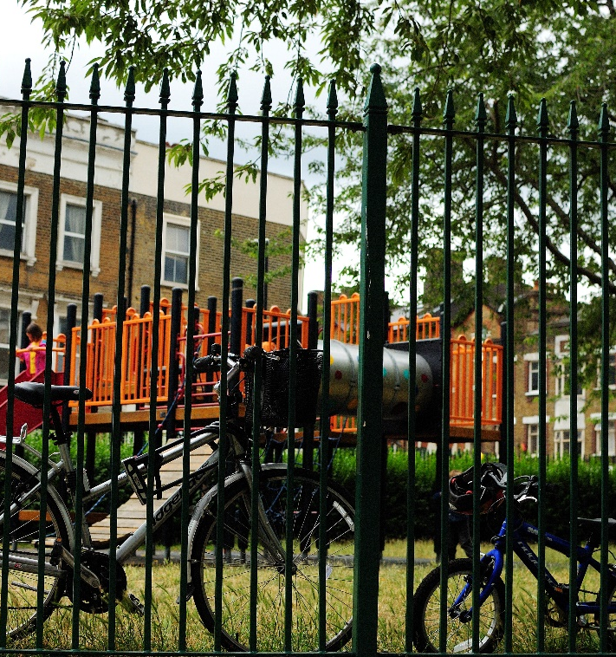

Overview
Establish: What is a 20-minute neighbourhood?
Explore: Walk round your local 20 min neighbourhood
Evaluate: How good is your local 20 min neighbourhood?
Engage: Improving your local 20 min neighbourhood
        What would you like to see addressed and how?
Notes:
This is the final session in the 20 minute neighbourhood workshop.
The aim of this session is to use the work done in previous sessions to engage with the wider community about the issues the pupils have found.
There are two suggested ways of engagement suggested here, but this session can be adapted to suit your local context.
The poster activity is more suited to younger pupils (primary), while the writing for older pupils (secondary).

Slide 3
What would you like to change?
Look back at the worksheet from the last session. Which issue did you identify as the thing you would most like to change?
Task: Create a mind map about the issue you think is the most important.
Make sure you can answer the following questions.
  What is the issue?
        What are the details? Where is it?
  Why is it an issue?
        What problems does it cause? Who does it impact?
  How would you like to see it address?
        What is your proposed solution? Why is this a good solution?
Notes:
This task could be done in groups, either by grouping together the students focusing on similar issues, or by getting each table/group to vote for the issue they want to focus on.

Slide 4
Option 1: Poster
Task: Create a poster about your issue
Make sure you include the main points from your mind map – what the problem is, why is it a problem, and how you would like to see it changed.
Perhaps your posters can be displayed somewhere in the school for parents, staff, and other pupils to see.
How to create an eye-catching poster
Use bright colours and large writing for you title
Try not to use too many words - you could write in bullet points
You could you a picture to help you explain
Notes:
Can also be done in groups.

Slide 5
Option 2: Write to a local representative
Local representatives help the people who live in their area to address local issues.
The best way to ask for their help or to make them aware of an issue is by writing to them.
Types of local representatives
Councillors - You will have several local councillors who represent your area on your local council. The council are responsibility for local services and policy, including planning, transport, roads, paths, education, social services, and libraries.
It is likely that you will need to write to your local councillors. You can find out who they are either by using your local council’s website, or through www.writetothem.com.
MSs - You will also have an MSP (Member of Senedd) who can help you with devolved matters, such as education, health, agriculture, justice, and prisons.
MPs - Your local MP (Member of Parliament - London) is responsible for UK matters and laws.
Notes:
Can also be done in groups / as a whole class.

Slide 6
Option 2: Write to a local representative
Task: Write a letter to your local representative(s) about your issue asking them for help
Use your mind map to help you write each section.
Structure
To start
Address you local representative with their full name e.g. Dear Danny Ashton
Introduction
Introduce yourself and the issue. Describe the issue and where it is in your local area.
Notes:
There is an example letter available.

Slide 7
Option 2: Write to a local representative
Section 1 – the problem
Clearly explain why it is a problem and provide evidence.
Who does it impact? Does anyone else agree that it is a problem? Is there any clear evidence (e.g. an overflowing bin)
Section 2 – your solution
Describe what you would like them to change and why this is the best solution. How would it solve your problem?
To finish
Briefly sum up what you have written.
Finish with a phrase like “I look forward to hearing back from you”.
Then sign off with ‘yours sincerely” and your full name(s).

Slide 8
Option 2: Write to a local representative
Task: Write a letter to your local representative(s) about your issue asking them for help
Tips for writing a great letter
Be polite and to the point. Clearly explain everything, but try not to ramble.
Include a photo or drawing if that would help you make your point.
Use your own words – they want to hear from you about what you think and why
Repeat your key point to reinforce it.
Use emotive language to have a bigger impact.
Directly address the person or people you’re writing to by using “you” and “your”

Slide 9
Option 2: Write to a local representative
Hearing back
You might not hear back straight away. Councillors are busy people, and will get lots of emails.
It usually takes a week or two to get a reply.
They might agree with you and tell you what’s already being done, or they might explain why the change you have suggested can’t happen at the moment.
Regardless of their reply, by writing to them, you have demonstrated that you care about your local area and want it be as good as possible.
Even if they can’t do anything about your issue at the moment, your letter will provide evidence that something needs to change. If enough people write in about the same issue, it will get addressed.
However, if you haven’t heard back after two weeks you could send them a follow up email.

Slide 10
Well done for completing the
20 minute neighbourhoods workshops!
For any questions about the workshops, or for further information about how we support schools in Wales please ActiveTravelSchoolPlan@sustrans.org.uk
www.sustrans.org.uk

