Slide 1
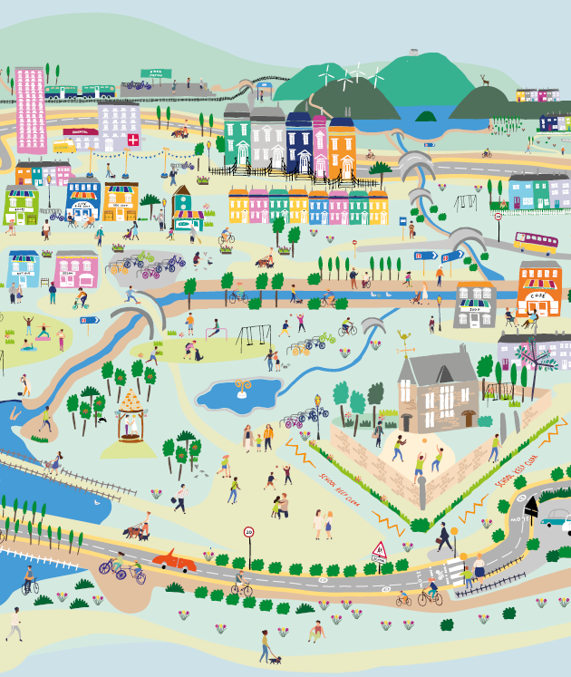



Session 1: Establish
Places that are good for the planet and for people

Slide 2
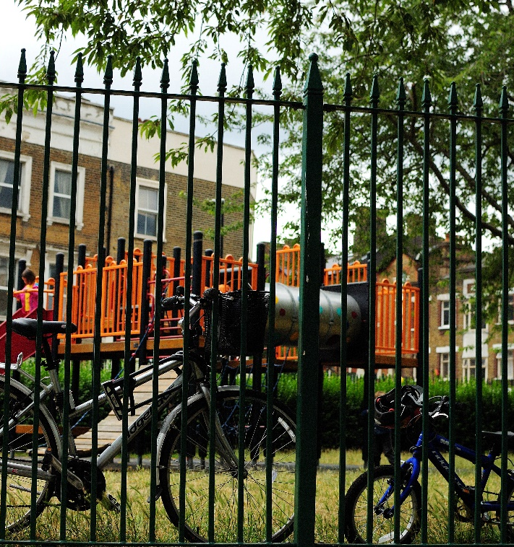
Overview
Establish: What is a 20-minute neighbourhood?
        What are the key features?
        What are the benefits?
Explore: Walk round your local 20 min neighbourhood
Evaluate: How good is your local 20 min neighbourhood?
Engage: Improving your local 20 min neighbourhood
Notes:
This is the first of four workshops, through which pupils will learn about 20 minute neighbourhoods.
The four sessions are outlined in the slide:
Establish – what is a 20 minute neighbourhood?
Explore – go out and explore your own 20 minute neighbourhood
Evaluate – is our local neighbourhood a 20 minute neighbourhood? What could be better?
Engage – how can we make change?
Overview of this session
What is a 20 minute neighbourhood?
What are the features of a 20 minute neighbourhood?
What are the benefits of a 20 minute neighbourhood?
Prepare for the next session – work out where we want to explore in our 20 minute neighbourhood.

Slide 3
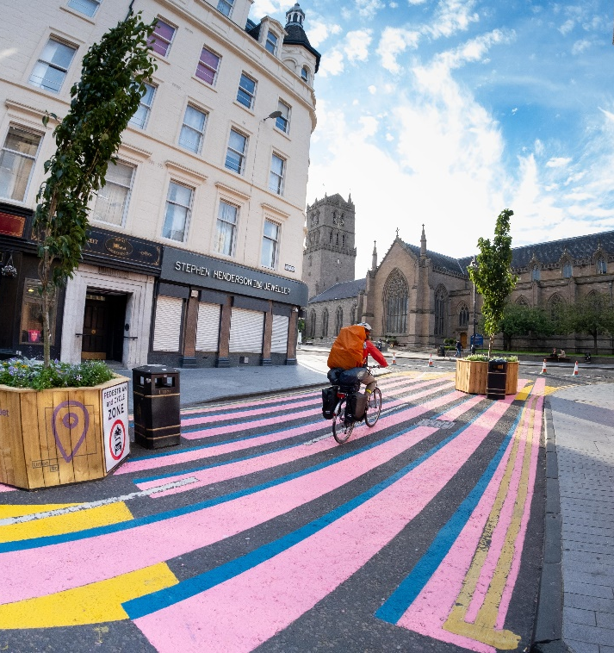
Sustrans
These workshops have been designed by Sustrans Scotland, a walking and cycling charity.
Their vision is a society where the way we travel creates healthier places and happier lives for everyone.
They work with schools across Wales to…
Notes:
These workshops have been designed by Sustrans Scotland, a walking a cycling charity.
Their vision is a society where the way we travel creates healthier places and happier lives for everyone.
Their mission is to make it easier for people to walk and cycle.

Slide 4
What are 20-minute neighbourhoods?
How can they help create places that are good for people and for the planet?

Slide 5
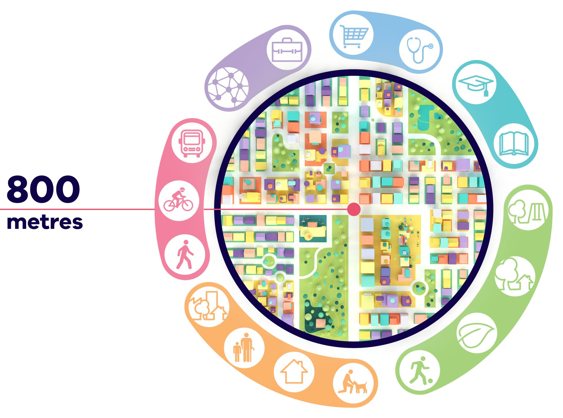
What are 20-minute neighbourhoods?
20-minute neighbourhoods are becoming popular across the world, and are being developing in cities such as Melbourne, Australia, Portland, USA, and Paris, France.
The following video is from Victoria State Government in Australia who want to make Melbourne into a city full of 20-minute neighbourhoods.
As you watch the video, take some notes.
You might want to watch the video more than once, or pause it to give yourself time.
From Plan Melbourne – 20-minute neighbourhoods
Notes:
As you watch the video, take some notes.
You might want to watch the video more than once, or pause it to give yourself time.

Slide 6
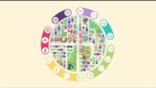

Slide 7
What are 20-minute neighbourhoods?
“20-minute neighbourhoods
give people the ability to meet most of their daily needs within a
20-minute walk from home,
with access to safe cycling and
local transport options”
From Plan Melbourne – 20 minute neighbourhoods
Notes:
The 20 minute neighbourhood is an idea that is becoming popular across the world.
Developed in different ways in cities like Melbourne, Portland and Paris, people can meet most of their essential needs within a 20 minute walk.
This means you can do your shopping, join in with leisure activities, take your children to school, find local services like your GP practice and ideally get to work – all within easy access of where you live.
It also means having greenspace on your doorstep and a local environment that encourages active travel to promote health and well‑being.
It is a place where people want to live, so affordable housing must be part of it.

Slide 8
What are 20-minute neighbourhoods?
Sustrans wants to see places that connect us to each other and to what we need, where we can thrive without using a car.
They want liveable cities and towns for everyone.
They think the best way to do this is to ensure that it is easy for people to get to most places by a short 20-minute return walk.
10 minutes there, 10 minutes back.
Why 20 minutes? Almost everyone can walk for 10 minutes in each direction. On average, this means that everything should be within an 800m (half a mile) walk.
But what do we need to make this happen? Watch the next video and add to your notes.
Notes:
At Sustrans, our goal for cities and towns is for them to be places that connect us to each other and what we need, where we can thrive without using a car.
We want liveable cities and towns for everyone.
We think that the best way to do this is to ensure that it is easy for people to meet most of their everyday needs by a short 20 minute return walk.
10 minutes there, 10 minutes back.
Why 20 minutes? Almost everyone can walk for 10 minutes in each direction. On average, this means that everything should be within an 800m (half a mile) walk.
But what do we need to make this happen? Watch the next video and add to your notes.

Slide 9


Slide 10
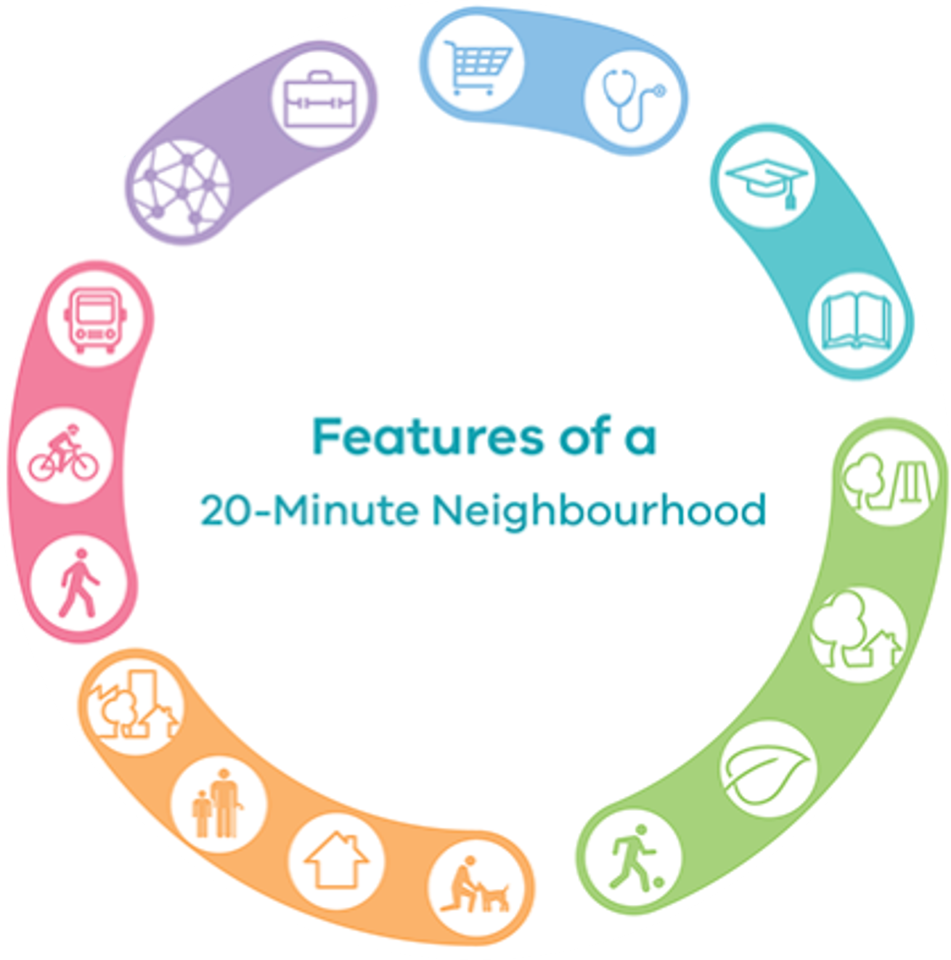
Features of a 20-minute neighbourhood
Task: In groups, create a mind map with all the features you think need to be included in a 20-minute neighbourhood.
Some questions to get you started:
What things were mentioned in the videos?
Where do you go at least once a month?
Is this different for other people?
E.g. people with young children, older people, working people
How could you categorise the features?
See the next slide for help
From Plan Melbourne – 20-minute neighbourhoods
Notes:
Mindmap in groups
Can use with or without hints/categories
Ask questions about where they need to go at least once a month, then get them to consider the needs of others.
For example they go to school, the park, to the supermarket, the cinema, whereas their parents might go to work, to the shops, to the doctors, to the train station etc.

Slide 11




















Features of a 20-minute neighbourhood
Places of work/learning
Places we need to go to
Features of a 20-minute neighbourhood
Places we live
Places we want to go to
How we get
about
Notes:
Mindmap in groups
Can use with or without hints/categories
Ask questions about where they need to go at least once a month, then get them to consider the needs of others.
For example they go to school, the park, to the supermarket, the cinema, whereas their parents might go to work, to the shops, to the doctors, to the train station etc.

Slide 12

Features of a 20-minute neighbourhood
Here are the features we came up with. Did you miss any? Did you think of any more?
Work / Learning
Education
Nurseries
Primary Schools
High Schools
Employment
Offices
Other places where people can work
Libraries
Places we need
Health
Doctors
Dentists
Pharmacy
Food
Shops
Places to eat
Money
Banks
Post Offices
Places we want
Entertainment
Cinema/theatre
Community halls
Religious spaces
Sport
Sport fields
Swimming pools
Outside
Public parks
Playgrounds
Hang-out spaces
Places to live
Houses
Well maintained
Different types
  Flats
  Houses
  Care homes
Streets
Clean and tidy
Trees and plants
Feeling safe
How we get about
Public Transport
Buses, trams, trains
Active Transport
Cycle lanes
Footpaths and pavements
Safe crossings
Cars
Slow speeds
Reduced traffic

Slide 13
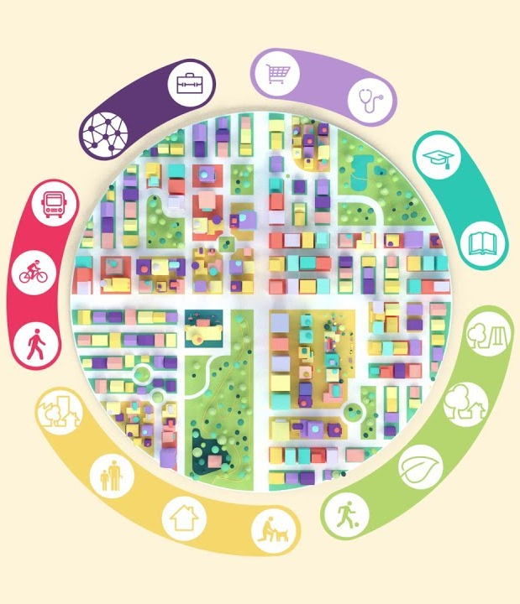
Route Planning
Your 20-minute neighbourhood
Where do you want to go?

Slide 14
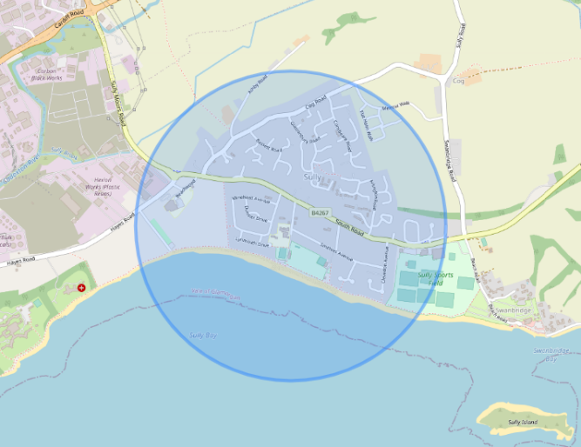
Your 20-minute Neighbourhood
Using your map, work out a walking route to take you round your 20-minute neighbourhood.
Think about the different things you want to find in your neighbourhood.
Places of work/education
Places we need
Places we want
Where we live
How we get there
Figure 1: Radius map created using CalcMap
Notes:
Plan the route as a class using google maps, and making sure you stay within the boundary shown on your map.
Use your radius map as a guide to make sure you stay within your 20 minute neighbourhood.
The map and instructions can then be printed to be used when outside.
When creating the route, consider the different elements of a 20 minute neighbourhood and try and plan the route around them, to showcase either what is or isn’t present in your neighbourhood.

Slide 15
Your 20 Minute Neighbourhood
Divide into groups to focus on different aspects of a 20-minute neighbourhood.
Work / Learning
Education
Nurseries
Primary Schools
High Schools
Employment
Offices
Other places where people can work
Libraries
Places we need
Health
Doctors
Dentists
Pharmacy
Food
Shops
Places to eat
Money
Banks
Post Offices
Places we want
Entertainment
Cinema/theatre
Community halls
Religious spaces
Sport
Sport fields
Swimming pools
Outside
Public parks
Playgrounds
Hang-out spaces
Places to live
Houses
Well maintained
Different types
  Flats
  Houses
  Care homes
Streets
Clean and tidy
Trees and plants
Feeling safe
How we get about
Public Transport
Buses, trams, trains
Active Transport
Cycle lanes
Footpaths and pavements
Safe crossings
Cars
Slow speeds
Reduced traffic
Notes:
OPTIONAL
Divide the groups into teams. These teams will each focus on a different aspect of 20 minute neighbourhoods when they explore their local area next session.

